Slide 1
Exercise 3.
Draw a logic circuit having 3 input wires and containing all basic and derived gates. Write the corresponding Boolean function, simplify it and then draw a simplified circuit equivalent to the initial one

Slide 2
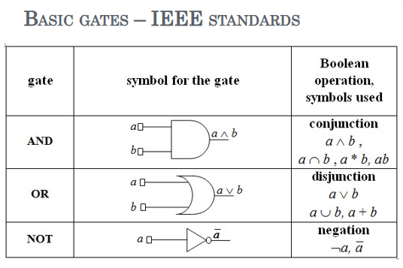

Slide 3
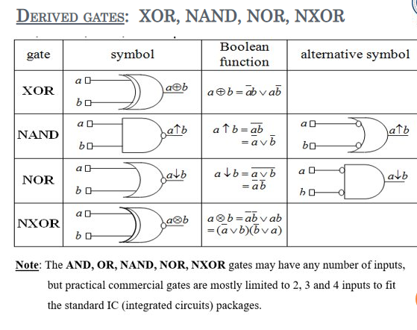

Slide 4
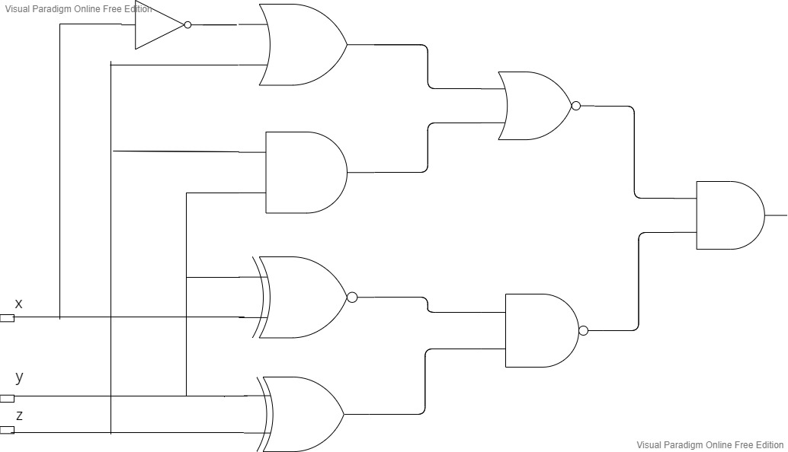
First circuit

Slide 5
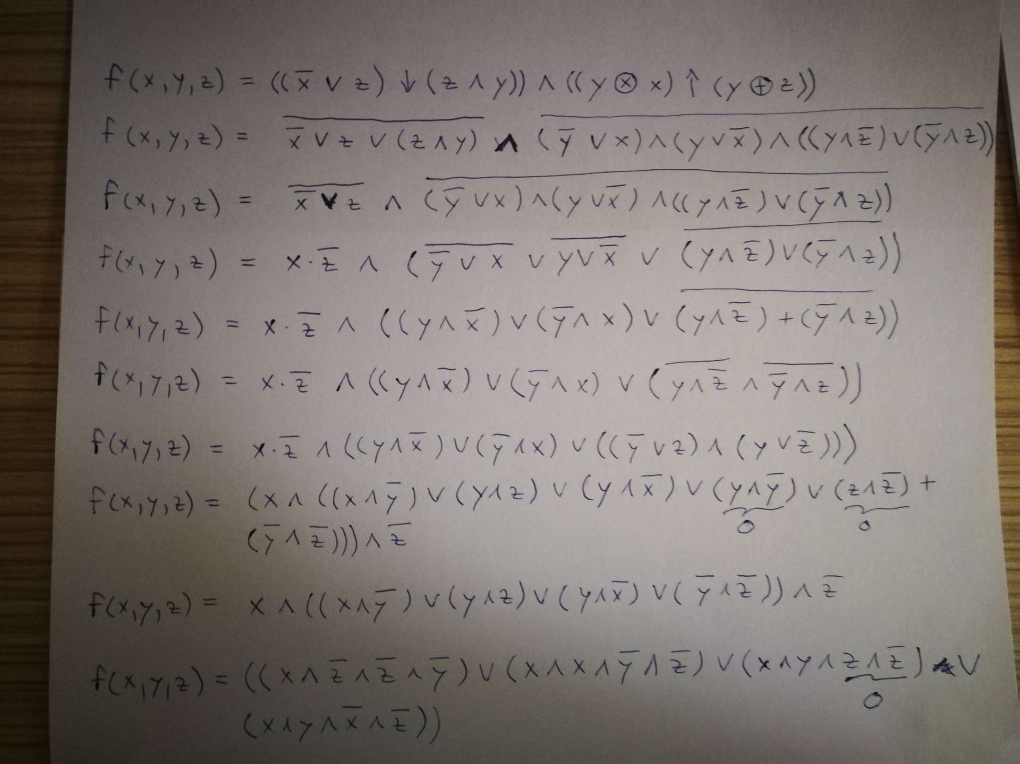
Simplification

Slide 6
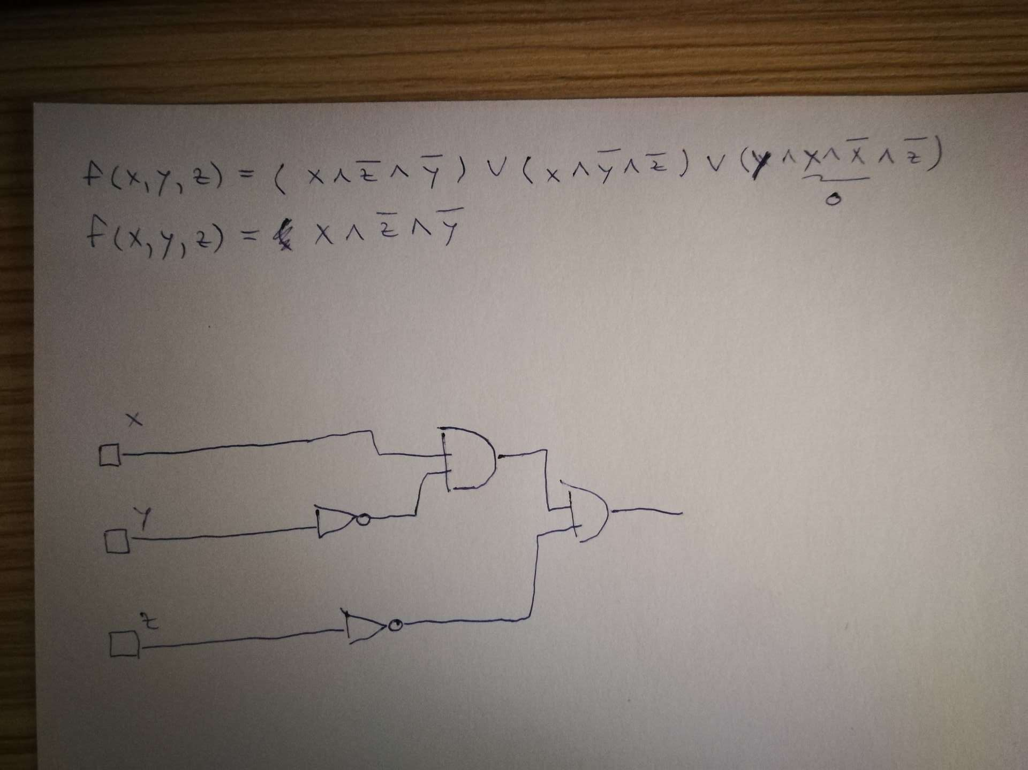
Final circuit

